Slide 1

DEliVERiNGSKiLLS
DRiViNGSUCCESS
www.VINSYS.COM

Slide 2
INTRODUCTION TO RDBMS

Slide 3
Introduction
What is data
What is information

Slide 4
Flat File System
Flat files are data files that contain records with no structured relationships. Additional knowledge is required to interpret these files such as the file format properties.(Delimiters)

Slide 5
Advantages of using Flat Files:
Cost effective - using a flat file costs practically nothing because data is stored as text files. No software is required other than the program that needs to access the data.
Platform Independent - since text files are universally accepted by all server platforms, there is no problem moving your database from one server to another.
Very Simple To Understand - how hard would it be to understand that records in a flat file are stored in one straight line and are separated by delimiters?

Slide 6
Disadvantages of using Flat Files:
Low Reliability & Integrity - flat files are very prone to data corruption especially if the size of the database grows beyond what the server resources are prepared to handle. e.g. 50,000 records in flat file & DML firing constantly.
Low Security - no security feature is built into a text file. It can be opened for viewing by anyone who happens to know where to look.
Limited Data Structuring - as mentioned a while ago, records are stored as lines of text by delimiters
Difficult To Integrate With Other Programs – relating data from one table with another is not possible
Only Character Type of data can fit into it

Slide 7
Disadvantages of flat file system
Data Redundancy & Inconsistency :-
Same data may be stored across various files causing repetition of data
This redundancy causes inconsistent state of data.
Concurrency Problem :-
Multiple users may access same data at same time causing inconsistency & locking problems

Slide 8
Relational Database Management System (RDBMS)
Relational databases store data as logically related tables.
Data is arranged in a tabular(rows-columns) manner
An important feature of relational system is that a single database can be spread across several tables. This differs from flat-file databases, in which each database is self-contained in a single table.
Avoids redundancy

Slide 9
RDBMS
Supports Large Amount Of Data
High Security & Reliability - security features such as password and user levels are usually built-in. Database records are also "locked" whenever they are accessed by a user hence preventing data corruption if and when a second user accesses the same record

Slide 10
RDBMS
Data Abstraction
The system hides certain details of how data is stored and maintained.
Actual complexity should be hidden from database users.

Slide 11
Levels of Abstraction
There are several levels of abstraction:
Physical Level
Conceptual Level
View Level

Slide 12
Levels of Abstraction
View 1
View 2
View n
Conceptual Level
Physical Level

Slide 13
Data Independence…
There are two kinds:
Physical data independence
Logical data independence

Slide 14
Different Database Products
Access –Good for Stand Alone machines
Grocery market
My SQL –Based applications(Free Downloadable Versions) But support only ANSII & work on only Windows .
Microsoft SQL SERVER –Comes with .Net
Sybase –For financial applications. Available for Unix, WinNT etc
ORACLE –Scalability factor, One of the leading database products. Also has wide range of tools

Slide 15
Database Language
DBMS normally provide specialized programming languages often called Database Languages
Different DBMS provide different database languages although a language called SQL has recently taken on the role of standard.

Slide 16
Database Language…
DRL/DQL – data query Language
DDL-data Definition Language
DML-data Manipulation Language
DCL-data Control Language
TCL-transaction Control Language

Slide 17
Database Design
Stages of SDLC
requirements specification,
design
implementation,
Testing,
Deployment,
Maintenance.

Slide 18
Data Model
What data is required
How it should be organized.
What data should be stored in the database

Slide 19
Is Similar to
an architect's building plans.
"blueprint" for building the physical database.

Slide 20
Data Model Types
Logical Model
Physical Model

Slide 21
Logical Model
Logical modeling deals with gathering business requirements and converting those requirements into a model.
The logical model revolves around the needs of the business, not the database, although the needs of the business are used to establish the needs of the database

Slide 22
Physical Model
Deals with the conversion of the logical, or business model, into a relational database model.
During physical modeling, objects such as tables and columns are created based on entities and attributes that were defined during logical modeling. Constraints are also defined, including primary keys, foreign keys, other unique keys, and check constraints.

Slide 23
Physical Model
Physical modeling is database software specific, meaning that the objects defined during physical modeling can vary depending on the relational database software being used.

Slide 24
Hierarchical Model
The hierarchical data model organizes data in a tree structure
This structure implies that a record can have repeating information, generally in the child data segments.
Data is in a series of records, which have a set of field values attached to it.
To create links between these, the hierarchical model uses Parent Child Relationships.
It restricts a child segment to having only one parent segment.
*Relationship is One to Many
E.g. Employees getting hardware from the company
Employees reporting to managers

Slide 25
Network Model
Some data were more naturally modeled with more than one parent per child.
So, the network model permitted the modeling of many-to-many relationships in data.
Here it is not necessary that 1 child must have single parent
In this model,data is represented by collections of records, and relationships among data are rep- resented by links

Slide 26
Example
Link between Relation-Customer & Relation Account.
LOAN-212
SHYAM
ENGINEER
SADASHIV PETH
RD-001
RAM
BUSINESSMAN
KHADAKI

Slide 27
Relational Model
In such a database the data and relations between them are organised in tables.
A table is a collection of records and each record in a table contains the same fields.
Properties of Relational Tables:
Values Are Atomic.
Each Row is Unique .
Column Values Are of the Same Kind .
The Sequence of Columns is Insignificant .
The Sequence of Rows is Insignificant .
Each Column Has a Unique Name

Slide 28
Relational Model
The tables within same database may be related with each other by defining different cardinalities and constraints
Entries of attributes are single valued
Entries of attributes are of same kind
No two rows are identical
The order of attributes is unimportant
The order of rows is unimportant
Every column can be uniquely identified
by its name and not by its position

Slide 29
Example
COULMN
Empno | Ename | Job | Mgr | salary
101 | JONES | CLERK | 105 | 9000
102 | SMITH | ACC |  | 3000
103 | JULLY | CLERK | 101 | 7000
104 | HIGGINS | SALES | 105 | 5000
TOUPLE/ROW
RELATION/TABLE
CELL

Slide 30
ORDBMS
Is same RDBMS but with features of Object Orientation.
objects, classes and inheritance are directly supported in database schemas and in the query language.
You can create customized data types & methods
It provides a middle ground between relational databases and object-oriented databases

Slide 31
Relational Database Terms
Entity: an object about which you want to store data
Relationships: links that show how different records are related
Key Fields: establish relationships among records in different tables
Five main types of key fields:
- Unique
primary keys
candidate keys
foreign keys
composite keys

Slide 32
Primary Keys
Primary key
Value must be unique for each record
Serves to identify the record
Present in every record
Can’t be NULL
Should be numeric

Slide 33
Candidate Keys
Candidate key
Any field that could be used as the primary key
Should be a unique, unchanging numeric field

Slide 34
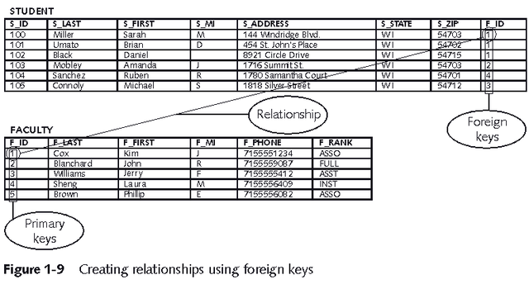
Foreign Keys
Foreign key: a field in a table that is a primary key in another table
Foreign key creates a relationship between the two tables
Foreign key value must exist in the table where it is a primary key

Slide 35
Composite Keys
Composite key: a unique key that you create by combining two or more fields
Usually comprised of fields that are primary keys in other tables

Slide 36
Relationships & Relationship Sets
A relationship is an association among two or more entities.
A relationship set is a collection of relationships of the same type.

Slide 37
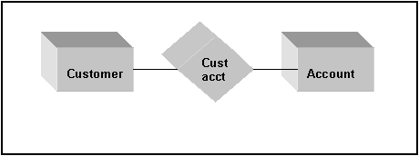
Binary Relationship
Relationship that involves two entities is called binary.

Slide 38
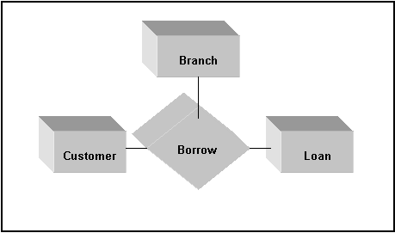
Relationships set may involve more than two entity sets

Slide 39
Roles in Entity
The role of an entity is the function it plays in a relationship.
For example, the relationship works-for could be ordered pairs of employee entities. The first employee takes the role of manager, and the second one takes the role of worker as shown in figure on the next slide.

Slide 40
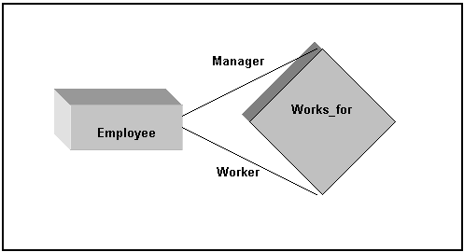
Employee Entities Interact via the relationship
“Works_for”

Slide 41
Mapping Cardinalities
Mapping Cardinalities expresses the number of entities to which another entity can be associated via a relationship.
For binary relationship between entity sets X and Y, the mapping cardinality must be one of:
One-to-One
One-to-Many
Many-to-One
Many-to-Many

Slide 42
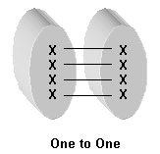
One-to-One
An entity in X is associated with at most one entity in Y, and an entity in Y is a associated with at most one entity in X.

Slide 43
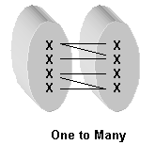
One-to-Many
An entity in X is associated with any number in Y. An entity in Y is associated with at most one entity in X.

Slide 44
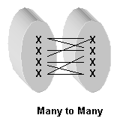
Many-to-Many
Entities in X and Y are associated with any number from each other

Slide 45
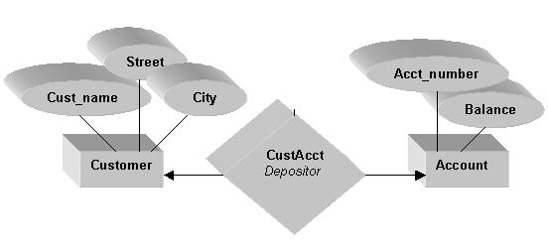
One to Many (1:N)

Slide 46
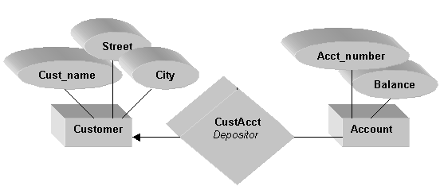
One to One (1:1)

Slide 47
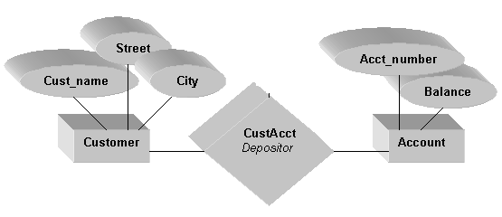
Many to Many (N:N)

Slide 48
Keys
An entity that depends does not have sufficient attributes & depends on some other entity is called a weak entity. One that does have a primary key is called a strong entity set.
The primary key of a weak entity is found by taking the primary key of the strong entity on which it is existence-dependent, plus the discriminator of the weak entity set.

Slide 49
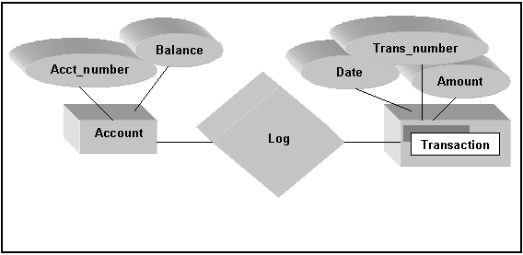
E-R diagram with a weak entity set

Slide 50
Specialization and Generalization
An entity set may contain subgroupings of entities that are distinct in some way of other entities.
An entity type E1 is a specialization of another entity type E2 if E1 has the same properties of E2 and perhaps even more.

Slide 51
Specialization and Generalization…
In E-R diagrams, specialization or generalization is shown by a triangle,
Specialization = top-down design.
Generalization = bottom-up design.
A lower-level entity set (subclass) inherits all the attributes and relationships participation of the higher-level entity set to which it is linked (superclass).

Slide 52
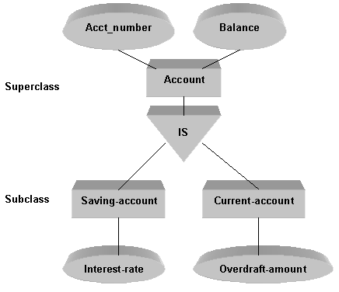
Generalization

Slide 53
Composite Attributes
Composite attributes can be divided into smaller subparts, which represent more basic attributes with independent meanings of their own.
For example, the Address attribute of the employee entity can be subdivided into Street, City, State and Zip.

Slide 54
Multivalue Attribute
A multivalued attribute may have upper and lower and upper bounds on the number of values for an individual entity.
For example, the colors attribute of a car may have between one and have five values, if we assume that a car can have at most five colors.

Slide 55
Derived Attribute
For example, the Age and Birthdate attributes of a person.
For a particular person entity, the value of age can be determined from the current date and the value of the person’s Birthdate.
The Age attribute is hence called a derived attribute and is said to be derivable from the Birthdate attribute, which is called a stored attribute.

Slide 56
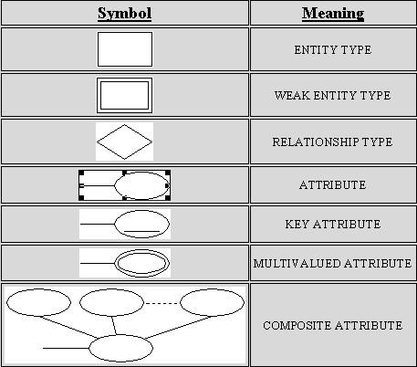
Summary of ER Diagram Notation

Slide 57
The Clearwater Traders Sales Order Database
Clearwater Traders
Markets a line of clothing and sporting goods via mail-order catalogs
Accepts customer orders via telephone, mail, and fax
Wants to begin accepting orders using its Web site
Has decided to offer 24-hour customer order service
Existing microcomputer-based database system cannot handle current transaction volume
Managers concerned that the current database does not have the failure-handling and recovery capabilities needed for an ordering system that cannot tolerate failures or downtime

Slide 58
Clearwater Traders Data Requirements
Customer name, address, daytime and evening telephone numbers, user names, and passwords
Order date, payment method (check or credit card), order source (catalog description or Web site), and associated item numbers, sizes, colors, and quantities ordered
Item descriptions and photo images, as well as item categories (women’s clothing, outdoor gear, and so on), prices, and quantities on hand. Many clothing items are available in multiple sizes and colors. Sometimes the same item has different prices depending on the item size
Information about incoming product shipments

Slide 59
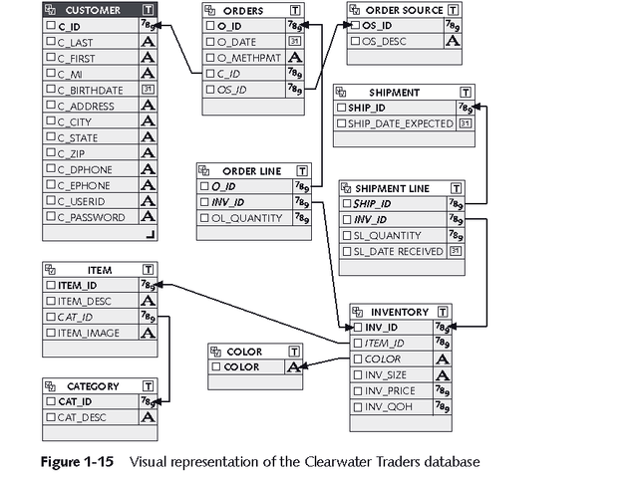
Clearwater Traders Table Relationships

Slide 60
The Northwoods University Student Registration Database
Northwoods University
Decided to replace its aging mainframe-based student registration system with a more modern client/server database system
School officials want students to be able to retrieve course availability information, register for courses, and print transcripts using personal computers located in the student computer labs

Slide 61
The Northwoods University Student Registration Database (cont)
Faculty members must be able to retrieve student course lists, drop and add students, and record course grades
Faculty members must also be able to view records for the students they advise
Security is a prime concern, so student and course records must be protected by password access

Slide 62
Northwoods University Data Requirements
Student name, address, telephone number, class (freshman, sophomore, junior, or senior), date of birth, PIN (personal identification number), and advisor ID
Course call number (such as MIS 101), course name, credits, location, duration, maximum enrollment, instructor, and term offered
Instructor name, office location, telephone number, rank, and PIN
Student enrollment and grade information

Slide 63
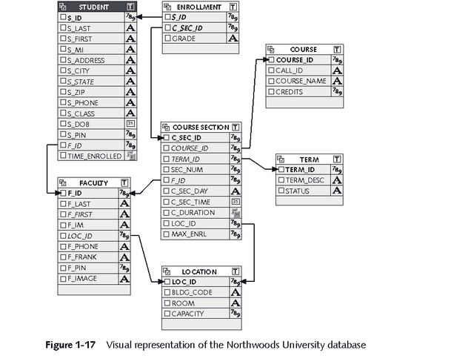
Northwoods University Table Relationships

Slide 64
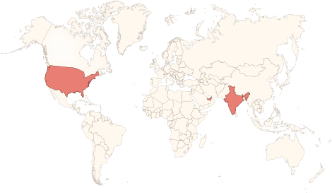






Physical Presence
www.vinsys.com
enquiry@vinsys.com
Shivaji Niketan, Tejas Society, Behind Kothrud Bus Stand, Near Mantri Park, Kothrud, Pune - 411029.
304, City Tower 2, Near Crown Plaza, Sheikh Zayed Road. Dubai, UAE.
PO.Box - 213279
132 West 31st Street, First Floor, New York, 10001, USA

